Slide 1
How will you travel through life?
MBD O-1-7
Notes:
Network will be non-directional, as capacity dispatched by scheduled carriers is bi-directional and most customers buy round-trips. It will be weighted by the different capacity metrics detailed above.

Slide 2
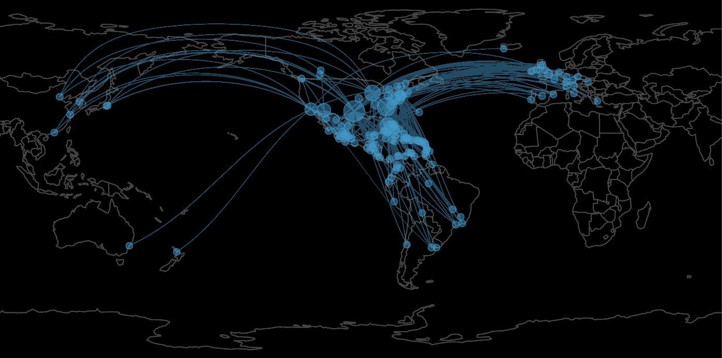
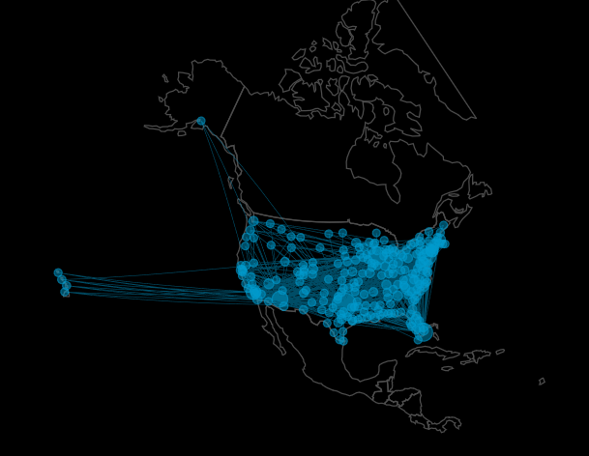

Network Visualizations - American Airlines
Notes:
Dataset of flights (domestic and international) for each airline with information of date, origin, destination, number of seats in each route, coordinates and distance for each route. Network will be non-directional, as capacity dispatched by scheduled carriers is bi-directional and most customers buy round-trips. Networks are weighted by seats and distance (in miles)

Slide 3
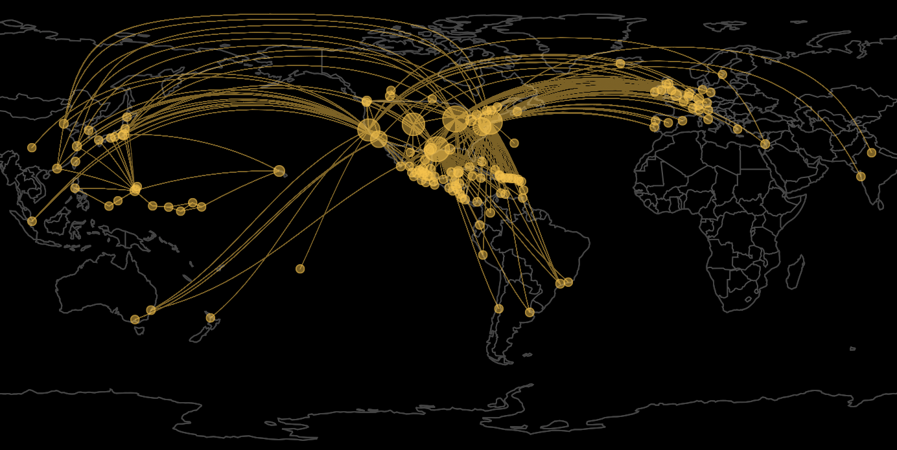
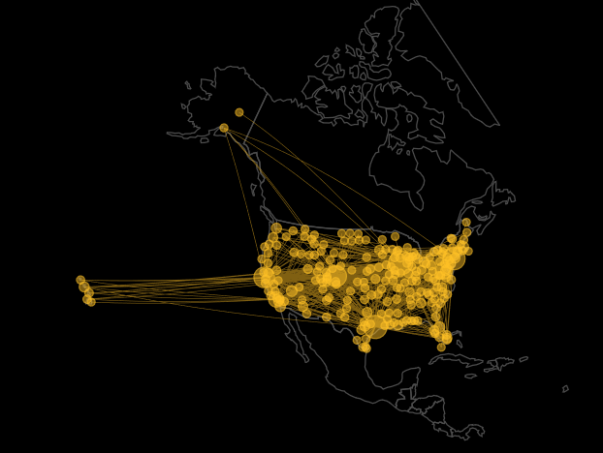

Network Visualizations - United Airlines

Slide 4
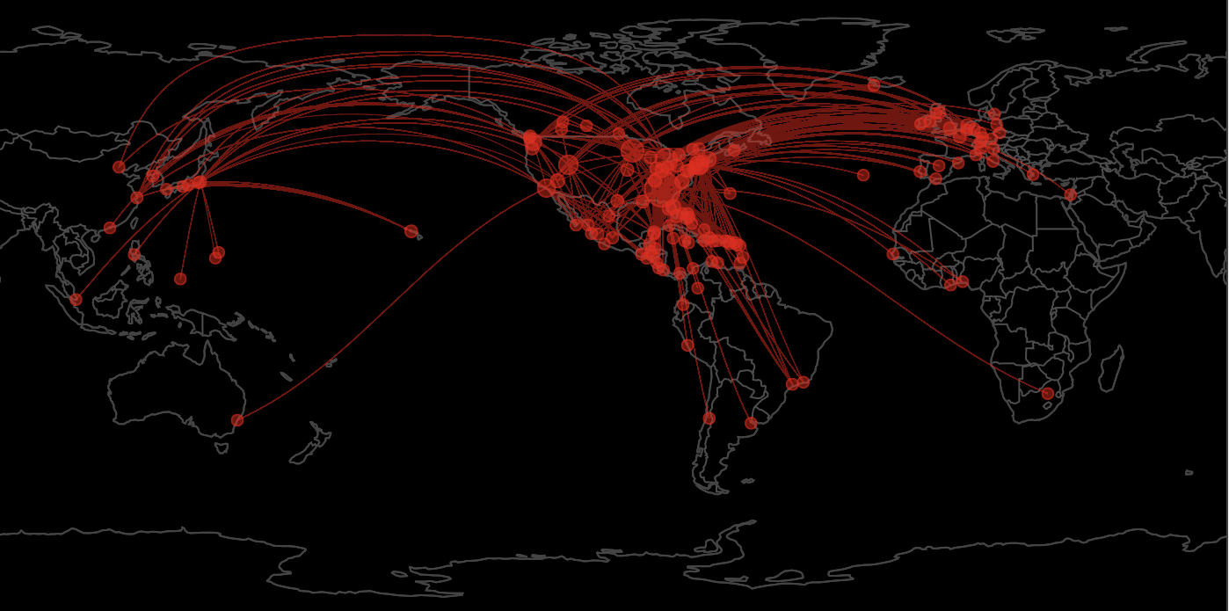
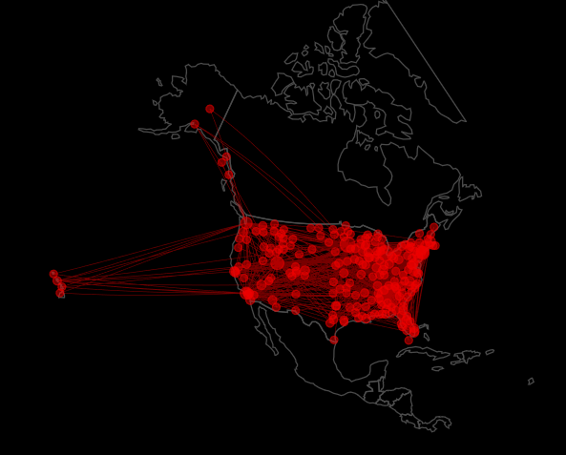

Network Visualizations - Delta Air Lines

Slide 5
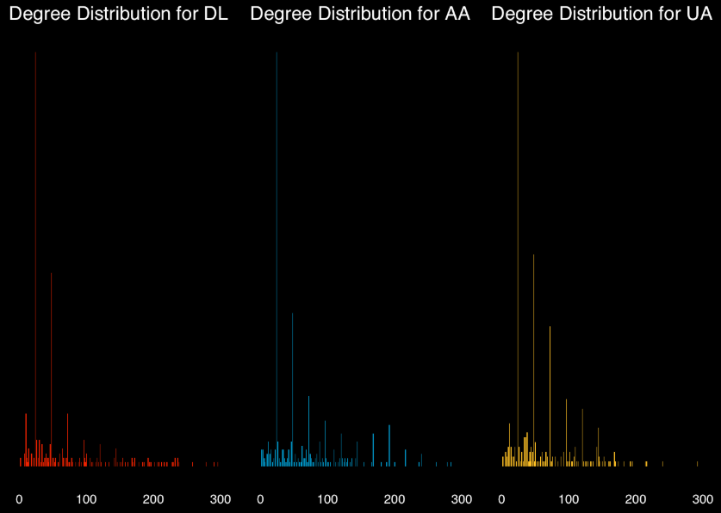
Degree Distribution
Right-Skewed Distributions
Notes:
As with most networks, our three airline networks have a right-skewed deegree distribution, implying few airports, i.e. the airlines’ hubs, are linked to many destinations across the world. Many more airports in the networks, are only linked to a few other nodes; typically the large hubs. In aviation, such airports are referred to as spokes. Delta, American, and United, all have adopted a ‘hub & spoke’ model, and thus present comparable degree distribution.

Slide 6
Nodes Importance
Atlanta (ATL)
Minneapolis (MSP)
Detroit (DTW)
Salt Lake City (SLC)
Dallas/Fort Worth (DFW)
Charlotte (CLT)
Chicago O’Hare (ORD)
Miami (MIA)
Chicago O’Hare (ORD)
Houston (IAH)
Newark (EWR)
Denver (DEN)
Degree Centrality
Betweenness
Closeness
Eigen Centrality
Notes:
Low centrality

Slide 7

Notes:
Network will be non-directional, as capacity dispatched by scheduled carriers is bi-directional and most customers buy round-trips. It will be weighted by the different capacity metrics detailed above.

Slide 8
Itinerary Quality Score (IQS)
Stopover Score: Number of Stopovers Needed
2. Hub Score: Number of Possible Routings
3. Circuity Score: % Increase in Distance over Nonstop
4. Capacity Score: Airline’s Seat Capacity on each Segment
5. Market Presence Score: Node’s Importance in Network

Slide 9
Itinerary Quality Score (IQS)
LAX
DAY

Slide 10
IQS (⅕): Stopover Score
Stopover Score: Number of Stopovers Needed
2
1/distances[origin,dest]

Slide 11
IQS (⅖): Hub Score
2. Hub Score: Number of Possible Routings
ATL
DTW
MSP
1-(1/(length(airport_list)))^2

Slide 12
IQS (⅗): Circuity Score
LAX
DAY
3,097 km.
3. Circuity Score: % Increase in Distance over Nonstop
1/((adj[origin,airport_list[i]] + adj[dest,airport_list[i]])/nonstop_dist)^2

Slide 13
IQS (⅘): Capacity Score
LAX
DTW
DAY
((adj_s[origin,airport_list[i]] + adj_s[dest,airport_list[i]])/(busiest_route)^(1/4)
4. Capacity Score: Airline’s Seat Capacity on each Segment

Slide 14
IQS (5/5): Market Presence Score
LAX
DTW
DAY
(DL_ec$vector[[origin]]^(1/6) +
DL_ec$vector[[dest]]^(1/6) + DL_ec$vector[[airport_list[i]]]^(1/6))/3
5. Market Presence Score: Node’s Importance in Network

Slide 15



IQS: Delta Air Lines Itineraries
MSP
ATL
DTW
1
2
3

Slide 16


IQS: All Airlines’ Itineraries
ORD
DEN
ORD
1
2
3

Slide 17


